Slide 1



BetterCrypto⋅org
Applied Crypto Hardening
David Durvaux
Brussels, 9th June 2014

Slide 2
Attendees Reminder:
What occurs in a M³AAWG meeting cannot be shared outside the membership
Blogging, tweeting, posting is NOT allowed EXCEPT for referencing or citing the specific content on official M³AAWG public sites, which can be reposted or used in articles. The official sites are: www.m3aawg.org/DM3Z, www.Twitter.com/maawg, www.Facebook.com/maawg, https://www.facebook.com/groups/maawg/
Respect M³AAWG anonymity: No publishing people or company names, except as cited on the official M³AAWG channels listed above
No use of Wireshark or similar products on the M³AAWG network
No photography - No video - No audio recording
Any exception requires written permission from the Executive Director and may require permission from the session members
All meeting attendees must wear and have their M³AAWG badge visible at all times during the meeting
Please silence all electronic devices; be courteous to those listening to the presentations
Treat all attendees respectfully in and out of sessions. No less will be tolerated.
Please review our meeting Conduct Policy at http://www.m3aawg.org/page/m3aawg-conduct-policy
For questions, please contact Jerry Upton at: jerry.upton@m3aawg.org

Slide 3






Reminders for Our Worldwide Friends
All meeting content is confidential: No photos, no video, no recording. See staff with questions.
L’ensemble du contenu de la réunion est confidentiel : les photos, vidéos et enregistrements sont interdits. Pour toute question, demandez conseil au personnel.
Todo el contenido de la reunión es confidencial: No está permitido sacar fotografías ni grabar vídeo o audio. Consulte con el personal si tiene alguna pregunta.
Der gesamte Inhalt des Meetings ist vertraulich: Keine Fotos, kein Video, keine Tonaufzeichnung. Bei Fragen wenden Sie sich an die Mitarbeiter.
会議の内容はすべて機密扱いです。 写真やビデオの撮影、録音は禁止されています。質問がある方は、スタッフまでご連絡ください。
所有会议内容均为保密信息：禁止拍照、录像、录音。如有疑问，请咨询职员。
회의에서 다루는 모든 내용은 기밀입니다. 사진 및 동영상 촬영과 녹음은 금지됩니다. 질문이 있으시면 직원에게 문의해 주십시오.

Slide 4
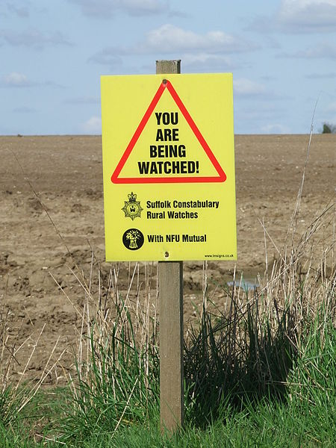
This talk is public and recorded

Slide 5
Why better crypto?

Slide 6


Slide 7
But of course...
It is not only the NSA, who intercepts
Other nations now have a blueprint (thanks to Snowden) in case they did not have the technical skills yet
Criminals now have a blueprint,...
Everyone has!
So, what can we do?

Slide 8
Don’t give them anything for free
It’s your home, your fight!
Notes:
Your fight??

Slide 9
Who (authors of bettercrypto)
Wolfgang Breyha (uni VIE),
David Durvaux (CERT.be),
Tobias Dussa (KIT-CERT),
L. Aaron Kaplan (CERT.at),
Florian Mendel (IAIK/A-Sit)
Christian Mock (coretec),
Daniel Kovacic (A-Trust),
Manuel Koschuch (FH Campus Wien),
Adi Kriegisch (VRVis),
Ramin Sabet (A-Trust),
Aaron Zauner (azet.org),
Pepi Zawodsky (maclemon.at),
And many other contributors!!

Slide 10
Agenda
Pieces of History
Introduction to BetterCrypto project
Cryptography in a nutshell
Practical Settings
Testing
Demo
Conclusion

Slide 11
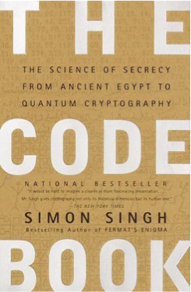
Pieces of History

Slide 12
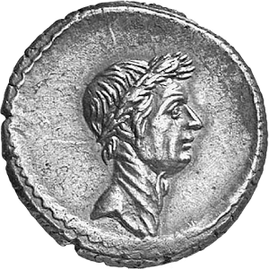
Historic ciphers
Caesar Cipher
Vigenère Cipher

Slide 13
BetterCrypto

Slide 14
Why?
Crypto is cryptic
A lot of difficult concepts
A lot of algorithms
A lot of parameters
…

Slide 15
The Idea
Really difficult for systems administrators
A “cookbook” can help!
That’s BetterCrypo

Slide 16
That’s not…
A crypto course
A static document

Slide 17
In brief
Community effort to produce best common practices for typical servers
Continuous effort
From diverse areas of expertise: sysadmins, cryptologists, developers, IT security pros
Open Source
Open to comments / suggestions / improvements

Slide 18
2 parts
First part = configurations
The most important part
Cover as many tools as possible
Second part = theory
Explain and justify choose we made
Transparency

Slide 19
How to use the bettercrypto guide?

Slide 20
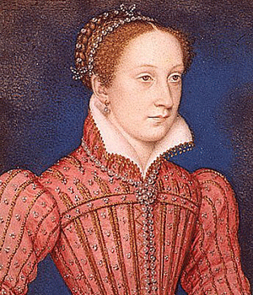
Mary Queen of Scots
Trial against Queen Elizabeth
Was executed after her code was broken (1587)

Slide 21
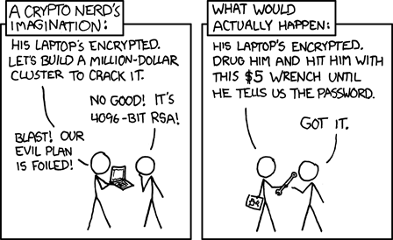
Crypto in a nutshell

Slide 22
Goals
2 types of goals:
protect the content of the message
Eavesdropping
Tampering
identify the author (signatures)
At least the one who controls the key
Can be combined

Slide 23
Symmetric Crypto
The key is shared
Notes:
Don’t forget:
Exchanging the key

Slide 24
Asymmetric Crypto
Public key is published
Private key HAS to be secured

Slide 25
Signing
Author’s identity is proved
Signed with the private key
Notes:
Maybe emphasize that for signing, you use *your* private key For encryption, you use *their* public key While to verify a signature, you use *their* public key Decryption: you use your private key

Slide 26
The asymmetric magic
RSA “formula” :
with
c which is the ciphertext
m is the cleartext message
e and n are the public key
Decipher with
d being the private key

Slide 27
Diffie-Helleman
How to share a secret key?

Slide 28
Ephemeral Diffie-Helleman
Regular mode
Public and private keys are kept
Ephemeral mode
New keys are generated each time
By both parties
Notes:
From Manuel: By both parties!
From Joe:
Best example I have found for this one is to base the regular case around RSA, and explain that it is just like any other public key operation: there's a public key associated with a cert, and that public key is consistently used for key exchange. Then talk about the ephemeral case. Might want to mention the fact that if you're not careful, you can end up with weak ephemeral keys (e.g., see https://www.imperialviolet.org/2013/06/27/botchingpfs.html http://www.metzdowd.com/pipermail/cryptography/2013-September/017323.html http://bugs.debian.org/cgi-bin/bugreport.cgi?bug=676563 http://nmav.gnutls.org/2011/12/price-to-pay-for-perfect-forward.html

Slide 29
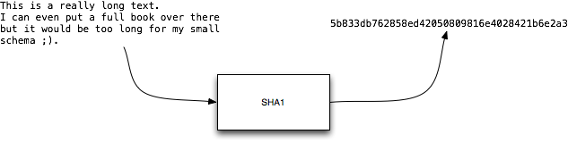
Hashing
Take long piece of data and produce a probably unique fingerprint
Probability of collision for SHA1:
1 over 1461501637330902918203684832716283019655932542976

Slide 30
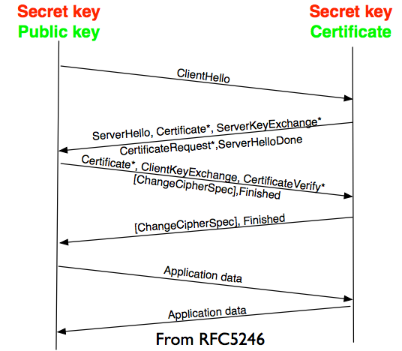
TLS
• Hello includes
• Random number
• Cipher suite
• Finished
• 1st cipher message with
negociated parameters
• Algorithm
• Key
• Secret
Notes:
From Joe:
Big fan of the Qualys SSL Tester (lots of SSL installs are really awful, a point I attempted to make in an earlier talk, see http://pages.uoregon.edu/joe/hardlook/hard-look.pdf ). Encourage folks to migrate to TLS 1.2 (get the heck off of TLS 1.0 and earlier!): can't do CGM unless on TLS 1.2. Contast TLS 1.2 vs. earlier versions as shown on slide 68 of my talk... Also want to make sure that folks are running the latest version of Apache (or NGINX or whatever) This may be a challenge if you're using RedHat5, for example...

Slide 31

Forward Secrecy-Motivation:
Lavabit example
Three letter agency (TLA) stores all ssl traffic
Someday TLA gains access to ssl-private key (Brute Force, Physical Force)
TLA can decrypt all stored traffic
Notes:
From Joe:
Strategies for getting the private key? a) Bribe a sysadmin (particularly easy if the same cert and private key is used on multiple systems, multiplying the population of potentially corruptible system administrators) b) Get court order compelling its production c) Exploit a technical vulnerability (such as Heartbleed) to get the private key d) Pick it up off unecrypted backups (if not password protected) e) Infect the system admin's workstation, then pick it up from there once you have the system admin's credentials (and, if needed, the password for the private key) [same cartoon]

Slide 32
Perfect Forward Secrecy
DHE: Diffie Hellman Ephemeral
Ephemeral: new key for each execution of a key exchange process
SSL private-Key only for authentication
Alternative new ssl private key every x days months
Pro:
Highest Security against future attacks
Contra:
Elliptic Curve
Processing costs
Notes:
From Joe:
Do you want to mention ECDHE by name, too?

Slide 33
Stream vs Block Cipher
Stream cipher
Generate an “infinite” key stream
Difficult to correctly use
Re-use of keys
Faster
Block cipher
Encrypt by block with padding
Could include integrity protection
Notes:
From Joe:
Only widely available stream cipher these days is RC4, and it's not secure (see my crypto BCP talk at slides 62-68) Do you want to mention GCM mode?

Slide 34
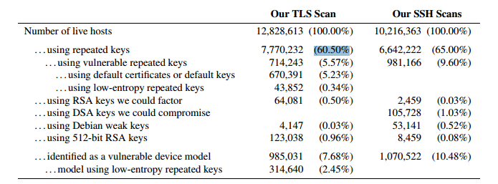
RNGs
RNGs are important.
Nadia Heninger et al / Lenstra et al
Entropy after startup: embedded devices
Notes:
From Joe:
Great little product: http://www.entropykey.co.uk/shop/ (but bummer it's backordered) Thoughts about http://egd.sourceforge.net/ ?

Slide 35
(p)RNGs
Weak RNG
Dual EC_DRBG is BROKEN (backdoored, used in RSA-toolkit)
Intel RNG ? Recommendation: add System-Entropy (Network). Entropy only goes up.
Tools (eg. HaveGE http://dl.acm.org/citation.cfm?id=945516)
RTFM
when is the router key generated
Default Keys ?
Re-generate keys from time to time
Notes:
From Joe:
Dual EC_DRBG is officially deprecated even by RSA itself :-) And then, of course, there was Extended Random, see http://threatpost.com/second-nsa-crypto-tool-found-in-rsa-bsafe/105143

Slide 36
Some algorithms
Symetric Ciphering
AES (Rijndael)
Camellia
Asymetric Ciphering
RSA
PGP (GPG)
Notes:
Do you want to discuss the scarce alternatives to NIST crypto algorithms at some point? (e.g., see slides 32-46)

Slide 37
Some algorithms
Hash
SHA1
SHA256
SHA512
Key Exchange
Diffie Helleman

Slide 38
Algorithm vs Implementation!
Heartbleed
Debian bug in Openssl (randomness was commented out)
Notes:
From Joe
Other implementation flaws: see my talk at 77-89 Might want to mention Schneier's "Mile High Pole" fallacy, see http://www.ietf.org/mail-archive/web/tls/current/msg12563.html Very hard to distinguish "honest accidental flaws" from intentionally introduced vulnerabilities. Bottom line: hard to know what and who to trust.

Slide 39
Heartbleed
/* Enter response type, length and copy payload */
*bp++ = TLS1_HB_RESPONSE;
s2n(payload, bp);
memcpy(bp, pl, payload);
payload (pl) and payload_length (payload) are controlled by attacker
memcpy will copy a part of the victim memory to the reply…

Slide 40
Cost of encryption
$ time openssl enc -e -a -aes-128-cbc -in ./rfc791.txt \ -out /tmp/rfc.aes -k "Super Key" -S 01EF
real 0m0.014s
user 0m0.004s
sys 0m0.003s
$ time gpg -a -u 57AB3358 -r 77659F3E -e ./rfc791.txt
real 0m0.069s
user 0m0.048s
sys 0m0.008s
GPG is 4,93 time slower!
Notes:
$ openssl enc -a -aes-128-cbc -in /tmp/demo.msg -out /tmp/demo.aes -k "Super Key" -S 01EF –e
$ openssl enc -a -aes-128-cbc -out /tmp/demo-back.msg -in /tmp/demo.aes -k "Super Key" -S 01EF –d
GPG key of 4096bits vs 128 bits AES encryption
Demo file is the IP RFC ;)

Slide 41
Keylengths
On the choice between AES256 and AES128: I would never consider using AES256, just like I don’t wear a helmet when I sit inside my car. It’s too much bother for the epsilon improvement in security.”
— Vincent Rijmen in a personal mail exchange Dec 2013

Slide 42
Keylengths
http://www.keylength.com/
Recommended Keylengths, Hashing algorithms, etc.
Currently:
RSA: >= 3248 bits (Ecrypt II)
ECC: >= 256
SHA 2+ (SHA 256,…)
AES 128 is good enough
Notes:
From Joe:
It would be nice if the symetric and asymetric crypto had comparable strength, eh? :-;

Slide 43
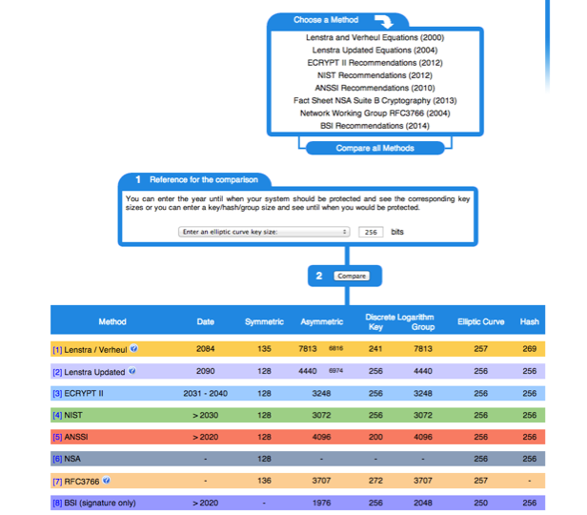
Notes:
Loop on the table!!

Slide 44
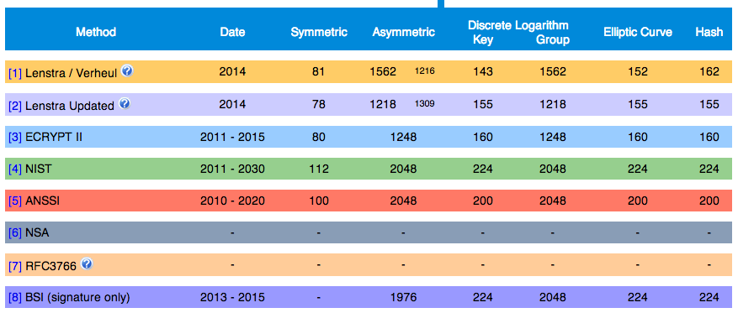
Notes:
Loop on the table!!

Slide 45
BetterCrypto CipherSuite
2 cipher suites
version A
stronger
less supported client
version B
weaker
more “universal”

Slide 46
Some general thoughts on settings
General
Disable SSL 2.0 (weak algorithms)
Disable SSL 3.0 (BEAST vs IE/XP)
Enable TLS 1.0 or preferably better
Disable TLS-Compression (SSL-CRIME Attack)
Implement HSTS (HTTP Strict Transport Security)
Notes:
From Joe:
I'd probably break TLS 1.0, as well as the earlier stuff

Slide 47
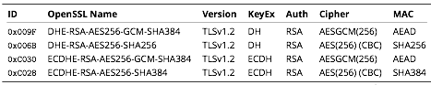
Cipher Suite A
TLS 1.2
Perfect forward secrecy / ephemeral Diffie Hellman
Strong MACs (SHA-2) or
GCM as Authenticated Encryption scheme
Notes:
From Joe:
Might want to clarify that the project's "Suite A" and "Suite B" aren't related to the NSA's "Suite B" specification Do you want to talk about why you don't do ECDSA instead of RSA in ECDHE-RSA-AES256-GCM-SHA384?

Slide 48
CiperSuite B
TLS 1.2, TLS 1.1, TLS 1.0
Allowing SHA-1
Notes:
From Joe:
Motivation for allowing SHA-1? Simple: most certs still rely on it. (see my crypto BCP talk at 57-61) Permitting TLS 1.0 is a tougher "sell" for me. I wouldn't allow it.

Slide 49
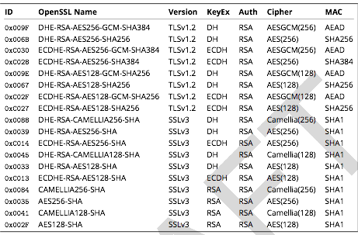
Cipher Suite B
Notes:
From Joe:
Rational for preferring CAMELLIA over AES?
Aaron:
Algorithmic agility argument. It has pros and cons. On the one had, AES is more trusted, on the other hand what if it turns out there is a backdoor there?
Also, be aware to cipher string lengths (c.f., http://rt.openssl.org/Ticket/Display.html?user=guest&pass=guest&id=2771 )

Slide 50
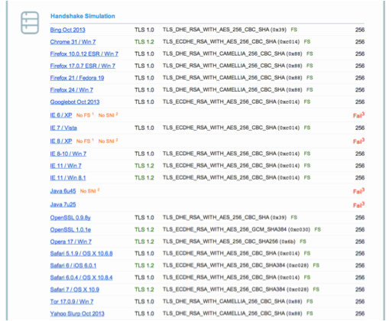
Compatibility (B suite)
Notes:
https://www.ssllabs.com/ssltest/analyze.html?d=www.ssllabs.com&s=173.203.82.166 (DEMO?)

Slide 51
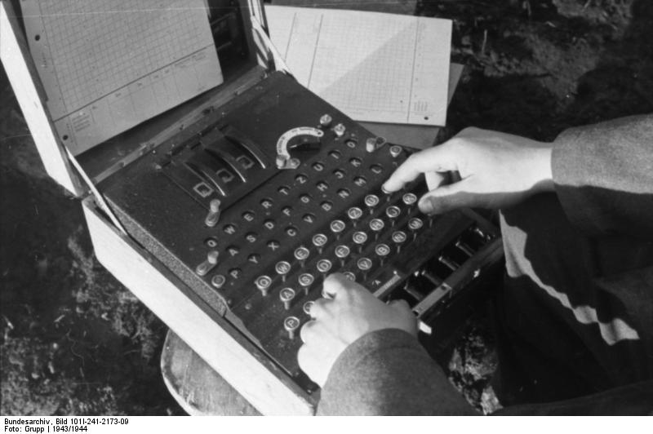
Enigma
Secret in code book

Slide 52
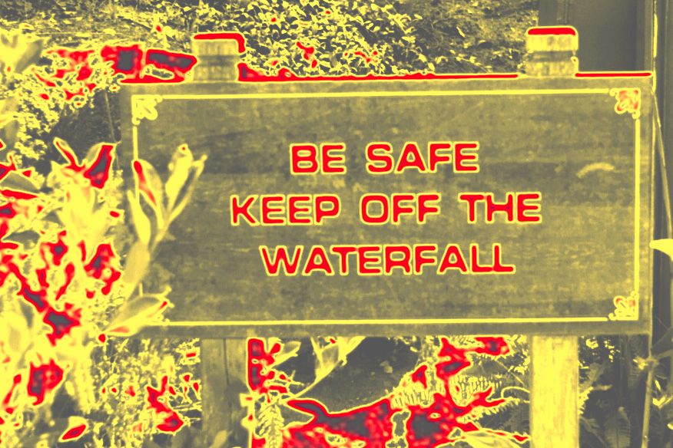
Practical Settings

Slide 53
Tools covered
Webservers
Apache
lighttpd
nginx
Microsoft IIS
Notes:
From Joe:
Will you be fleshing those out, or are they going to stay the way they currently are? FWIW, expect significant interest around email (SMTP, POP/IMAP, SMTP Submit) and web (e.g., for web email)

Slide 54
Tools covered
SSH
Open SSH
Cisco ASA
Cisco IOS

Slide 55
Tools covered
Mail servers
Dovecot
cyrus-imapd
Postfix
Exim

Slide 56
Tools covered
VPN
IPSec
CheckPoint Firewall-1
OpenVPN
PPPTP
Cisco ASA
OpenSWAN
tinc

Slide 57
Tools covered
PGP/GPG
IPMI/ILO
Instant Messaging
ejabberd
OTR
Charybdis
SILC

Slide 58
Tools covered
Database systems
Oracle
MySQL
DB2
PostgreSQL

Slide 59
Tools covered
Proxy
squid
Bluecoat
Pound
Kerberos

Slide 60
Mail Encryption
GPG / PGP – end to end protection
Use public / private crypto to protect your emails
Chain of trust
Independent of the mail client / transport layer
Can be used to verify author and/or protect content
STARTTLS for SMTP – in transit
Notes:
From Joe:
s/PGG/PGP I'd be interested to hear if you believe E2E encryption (e.g., use of PGP or S/MIME) is ultimately the solution Do you also want to talk about how email is actually hop-by-hop, and some hops may be opportunistically encrypted, while others may not be? (and how traffic will be exposed while it transits the intervening nodes?) I've become a fan of Postfix's nomenclature for opportunistic encryption: Postfix nomenclature (http://www.postfix.org/FORWARD_SECRECY_README.html) -- Anonymous (no peer certificate) -- Untrusted (peer cert not signed by trusted CA) -- Trusted (peer cert signed by trusted CA, unverified peer name) -- Verified (peer cert signed by trusted CA, verified peer name; or peer cert with expected public key or cert fingerprint) MITM risk is hard to mitigate, I think... Be sure to cover what happens if opportunistic encryption fails... is something better than nothing? Or is the right answer, "Hard core or nothing?" BTW, terrific article on STARTTLS from Facebook (Mike Adkins, you'll meet him at Brussels): https://www.facebook.com/notes/protect-the-graph/the-current-state-of-smtp-starttls-deployment/1453015901605223

Slide 61
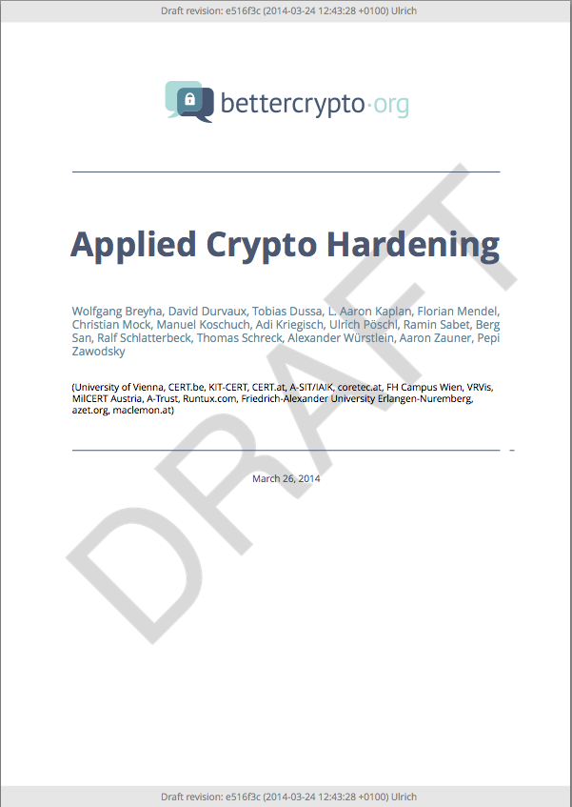
Let’s have a look

Slide 62
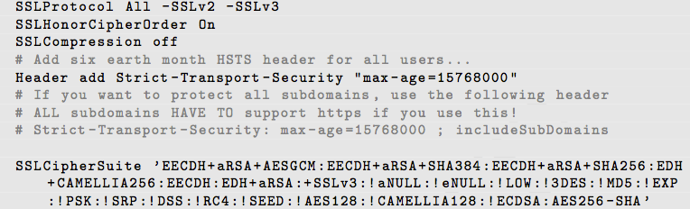
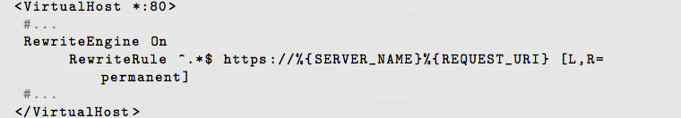
Apache
Selecting cipher suites:
Additionally:
Aaron

Slide 63
Mail Server
SMTP make use of opportunistic TLS
3 modes for mailservers
Mail Submission Agent (MSA)
Receiving Mail Transmission Agent (MX)
Sending Mail Transmission Agent (SMTP client)

Slide 64
Mail Server
Correct DNS configuration without CNAMEs
Enable encryption
NO self-signed certificates

Slide 65
SMTP client mode
Hostname used as HELO must match the PTR RR
Setup a client certificate
Common name or alternate subject name must match the PTR RR
Don‘t touch cipher suite

Slide 66
MSA
Listen on port 587
Enforce SMTP AUTH
No SMTP AUTH on unencrypted connections
(use recommended cipher suites)

Slide 67
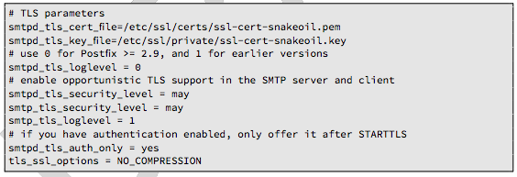
Postfix: MX & SMTP client
In main.cf
Enable opportunistic TLS

Slide 68
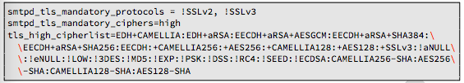
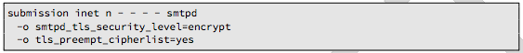
Postfix: MSA
Define ciper suite:
Configure MSA SMTP:

Slide 69
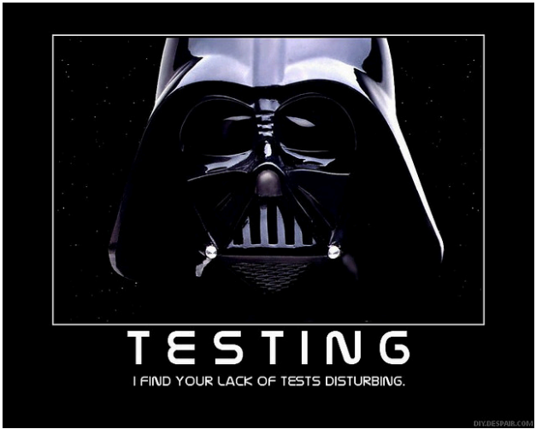
Testing

Slide 70
How to test? - Tools
openssl s_client (or gnutls-cli)
ssllabs.com: checks for servers as well as clients
xmpp.net
sslscan
SSLyze

Slide 71
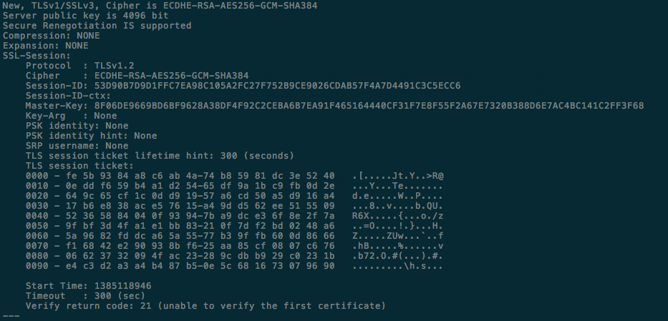
Tools: openssl s_client
openssl s_client -showcerts –connect git.bettercrypto.org:443

Slide 72
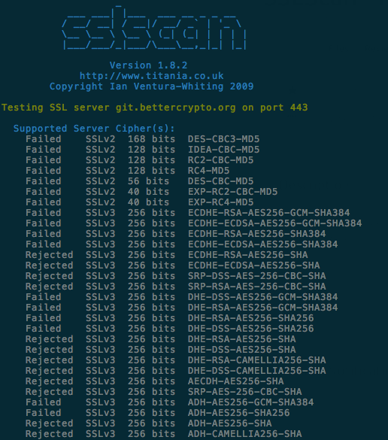
Tools: sslscan

Slide 73
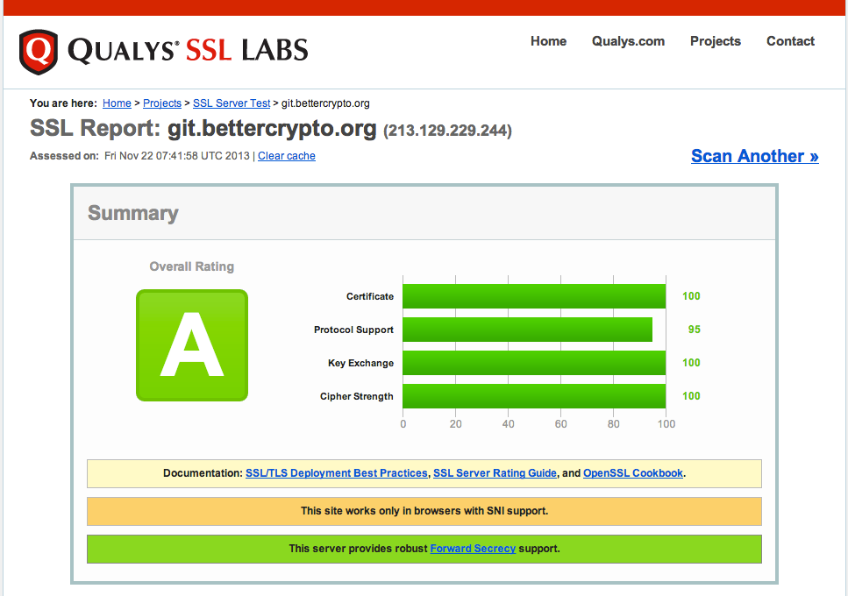
Tools: ssllabs

Slide 74
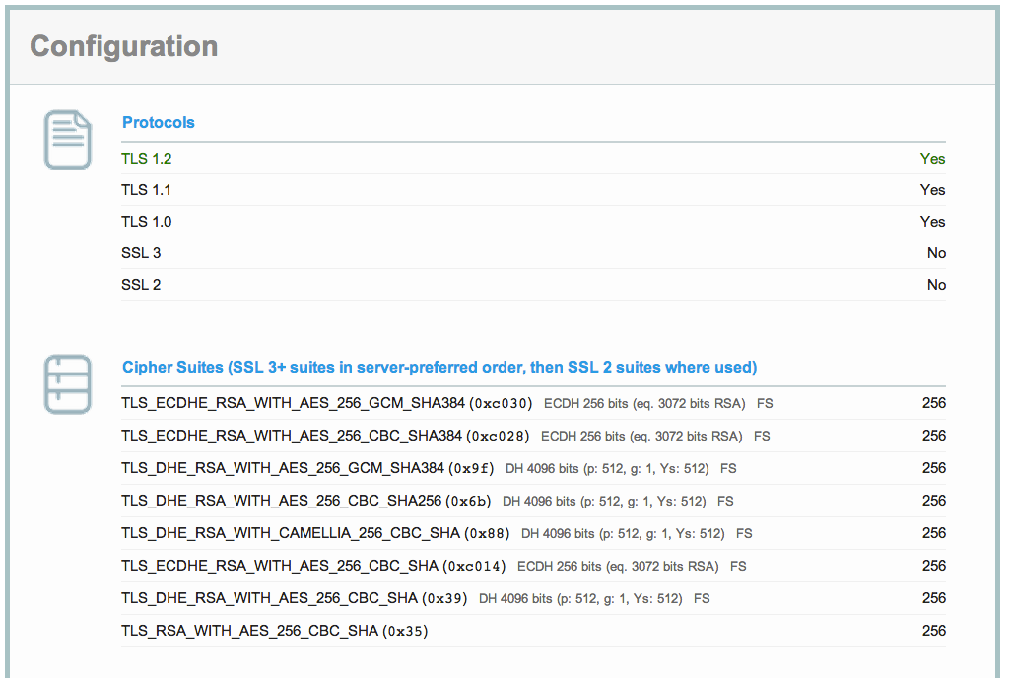
ssllabs (2)

Slide 75
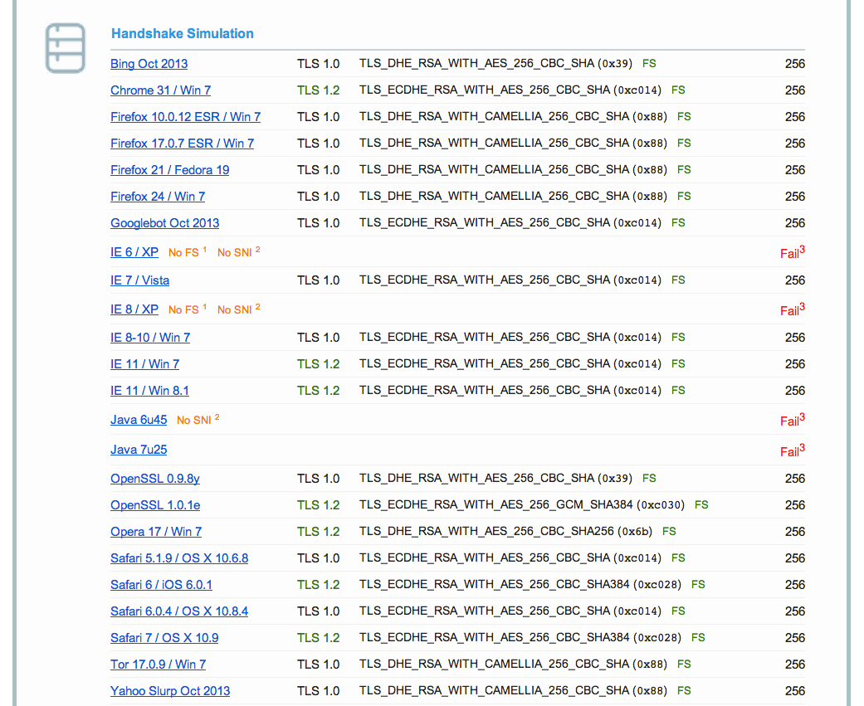
Ssllabs (3)

Slide 76
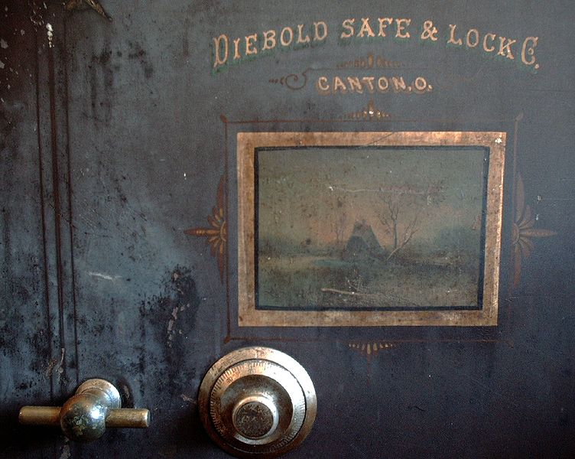
Demo

Slide 77
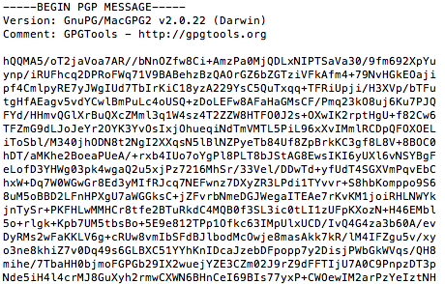
GPG - Ciphering
echo "This is a really secret" \ | gpg -a -u <your id>-r <his id> -e

Slide 78
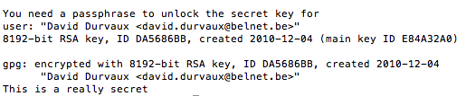
GPG - Unciphering
Let’s save the ciphered text to msg.asc
Then uncipher…
gpg -d msg.asc

Slide 79
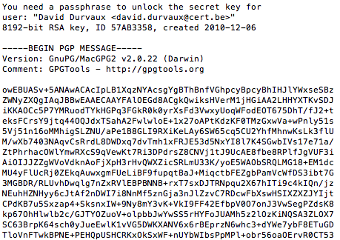
GPG - Signing
echo "This is a really secret" \ | gpg -a -u <your id>-r <his id>-s

Slide 80
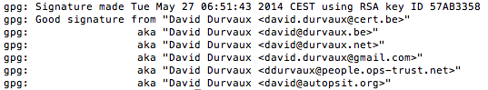
GPG – Check Signature
gpg --verify sig.asc
Differents way to sign / verify:
https://www.gnupg.org/gph/en/manual/x135.html
Other techniques
Clearsigned Documents
Detached Signatures

Slide 81
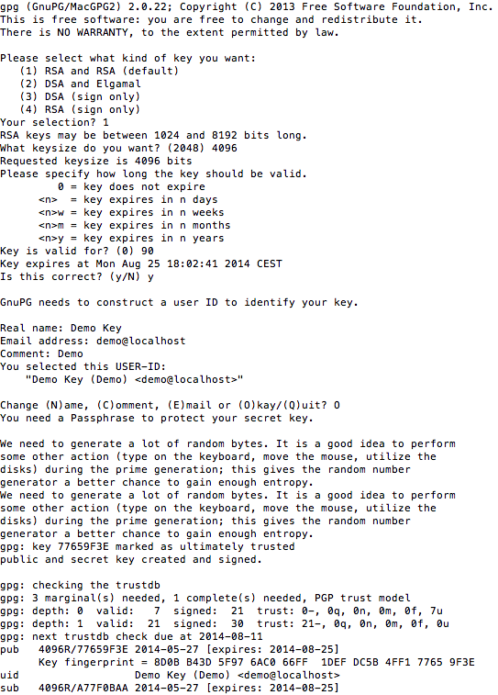
GPG Key generation
gpg --gen-key
Kind of Key
Keylength
Expiration Period
Notes:
From Joe:
Note that the version you're using may not be part of the mainline GnuPG distro (at least I couldn't find it on the GPG web site) Show doing an elliptic curve key, too?

Slide 82
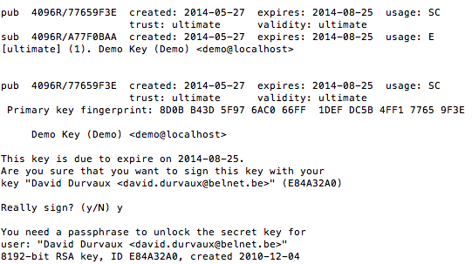
GPG – Key signing
gpg --sign-key -u <your ID> <his id>

Slide 83

GPG – Let’s do it!
Let’s do a key party!

Slide 84
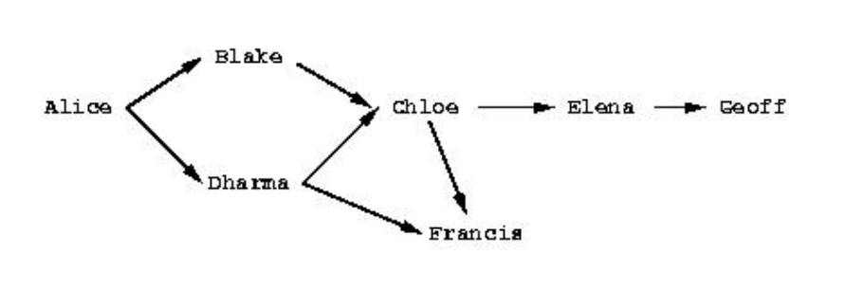
GPG – Sending key
gpg --send-keys <key id>
Notes:
From Joe:
Beware that some folks harvest social graphs from key signings on public keyservers (e.g., http://cryptome.org/2013/07/mining-pgp-keyservers.htm )

Slide 85
GPG - Integration
Enigmail (Thunderbird)
GPGMail (Apple Mail)
Symantec PGP
…

Slide 86
Other nice user tools
Ciphered containers:
TrueCrypt ➔ might want to switch now?
Apple’s FileVault2
Password containers
KeePass
LastPass
…
Notes:
From Joe:
Truecrypt reference: check. Something weird's happening today. Don't know what to think about it (yet). Keepass: good. Also Lastpass. Multifactor? Client certs? If you're inclined: -- Talk about revocation (not working) -- Want to talk about DANE? -- Traffic analysis? -- Any discussion of browsers and their crypto support? -- SNI exposure?

Slide 87
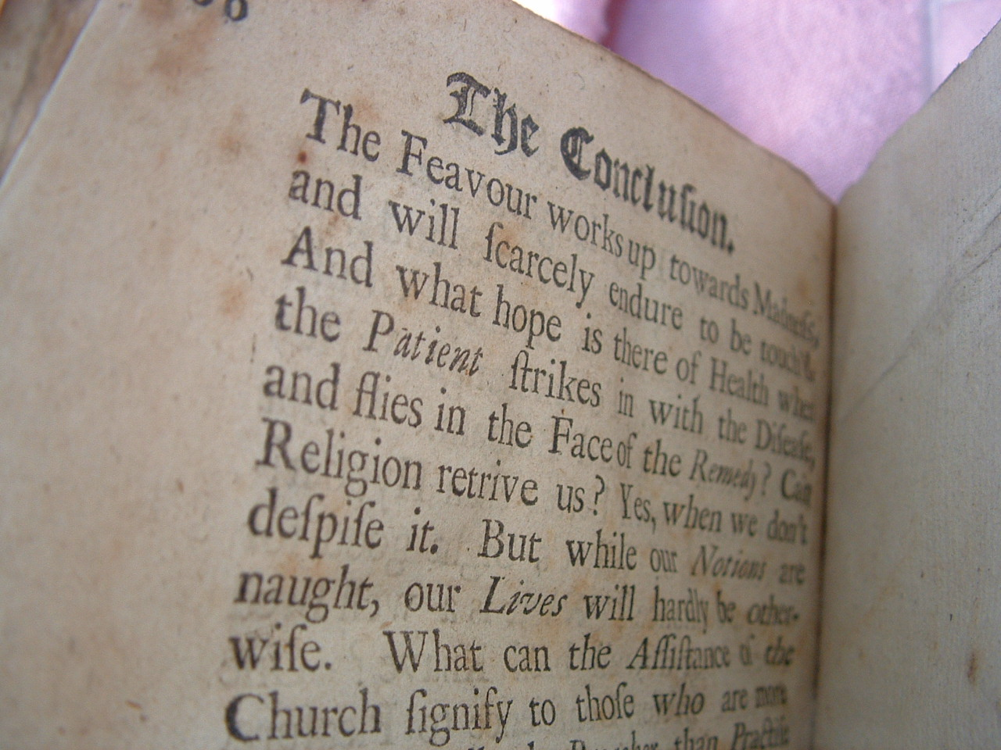
Conclusion

Slide 88
Future ideas
Configuration Generator (online)
Other tools
Other protocols

Slide 89
Current state as of 2014/05/31
Solid basis with Variant (A) and (B)
Public draft was widely presented at the CCC, RIPE meeting, IETF Strint workshop, Linuxdays, ..., M3AAWG
Section „cipher suites“ still a bit messy, needs more work
Need to convert to HTML

Slide 90
How to participate
We need: cryptologists, sysadmins, hackers
Read the document, find bugs
Subscribe to the mailing list
Understand the cipher strings Variant (A) and (B) before proposing some changes
If you add content to a subsection, make a sample config with variant (B)
Git repo is world-readable
We need:
Add content to an subsection from the TODO list → send us diffs
Reviewers!

Slide 91
Thank you!
BetterCrypto.org
https://git.bettercrypto.org/ach-master.git
http://lists.cert.at/cgi-bin/mailman/listinfo/ach
Contact
david@autopsit.org — @ddurvaux

Slide 92
More?

Slide 93
ECC
Elliptic curve cryptography (ECC)
Finding the discrete logarithm of a random elliptic curve element
Only knowing a base point
Assumed to be hard
Reduced key length

Slide 94
Some thoughts on ECC
Currently this is under heavy debate
Trust the Math
eg. NIST P-256 (http://safecurves.cr.yp.to/rigid.html)
Coefficients generated by hashing the unexplained seed c49d3608 86e70493 6a6678e1 139d26b7 819f7e90.
Might have to change settings tomorrow
Most Applications only work with NIST-Curves
Notes:
From Manuel and Azet: What do you exactly want to say with the « nothing up my sleeves »?
From Joe:
My thoughts on ECC? see my talk (previously mentioned) at slides 69-76 Nice pointers to some resources on ECC support in http://www.symantec.com/content/en/us/enterprise/white_papers/b-wp_ecc.pdf at pps. 23-24 (caution: may be dated, reconfirm/check with the Symantec person if so inclined) Handy check for OpenSSL: % openssl ecparam -list_curves

